Slide 1


Could synchrotron light sources benefit from the experience at CERN with beams split in horizontal phase space?
M. Giovannozzi - CERN
A. Franchi, N. Carmignani - ESRF
Acknowledgements: A. Bazzani, C. Frye, S. Gilardoni, C. Hernalsteens, A. Huschauer, S. Liuzzo, G. Sterbini, G. Turchetti.

Slide 2
Outline
The need of stable islands for proton rings (the CERN case)
Dynamic use of stable islands (with application)
Static use of stable islands
Stable islands for lepton rings
Possible applications of static and dynamic stable islands
Conclusions and outlook
Experimental activities on the use of stable islands covered in the talk by P. Goslawski - BESSY

Slide 3
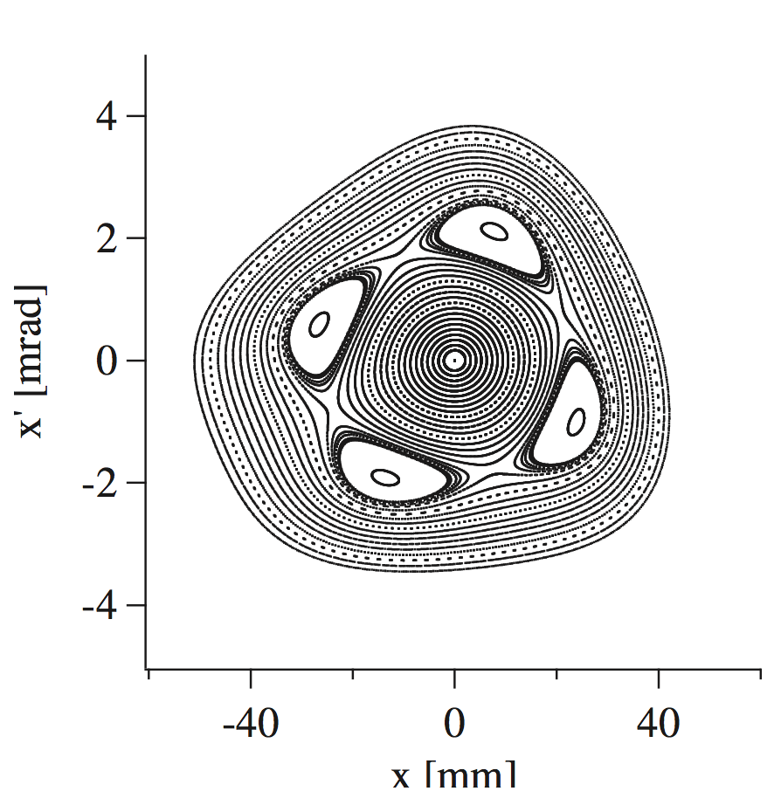
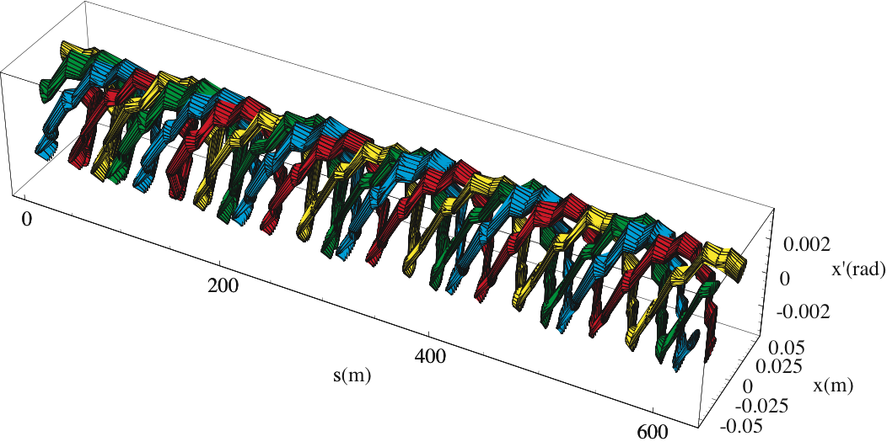
Introduction - I
Stable islands provided a more efficient way of extracting beams over few turns from a circular machine.

Slide 4
Introduction - II
Starting from the original application of stable islands, several others can be envisaged, well beyond the original goal.
Two scenarios can be considered
  Dynamic use of stable islands
  Static use of stable islands

Slide 5
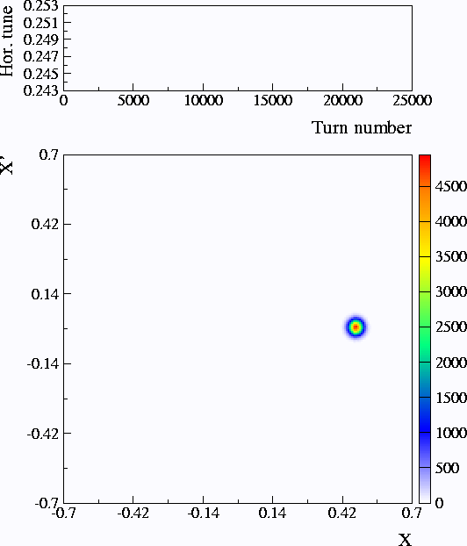
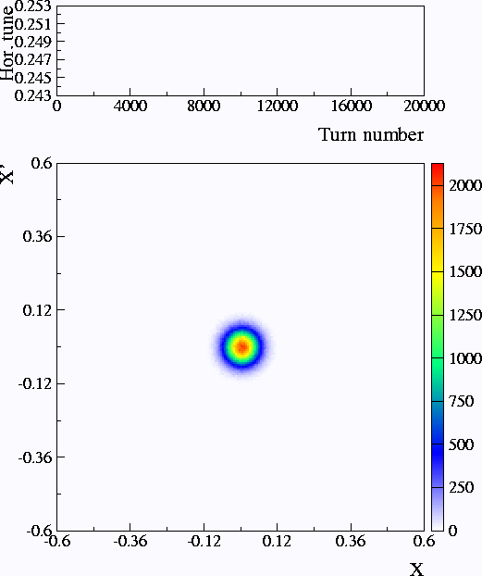
Dynamic stable islands
The transverse position of the stable islands is controlled by: tune, strength of sextupoles, octupoles…
By adiabatically changing any of these parameters it is possible to
Merge several beamlets into a single one. This could be an option for Multi-Turn Injection (MTI).
Split of a standard beam into several beamlets. This is the heart of the CERN PS Multi-Turn Extraction (MTE)

Slide 6
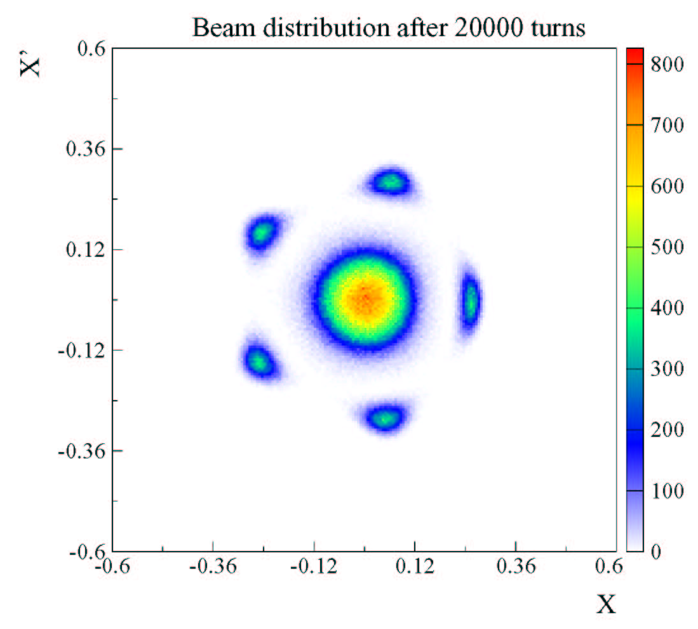
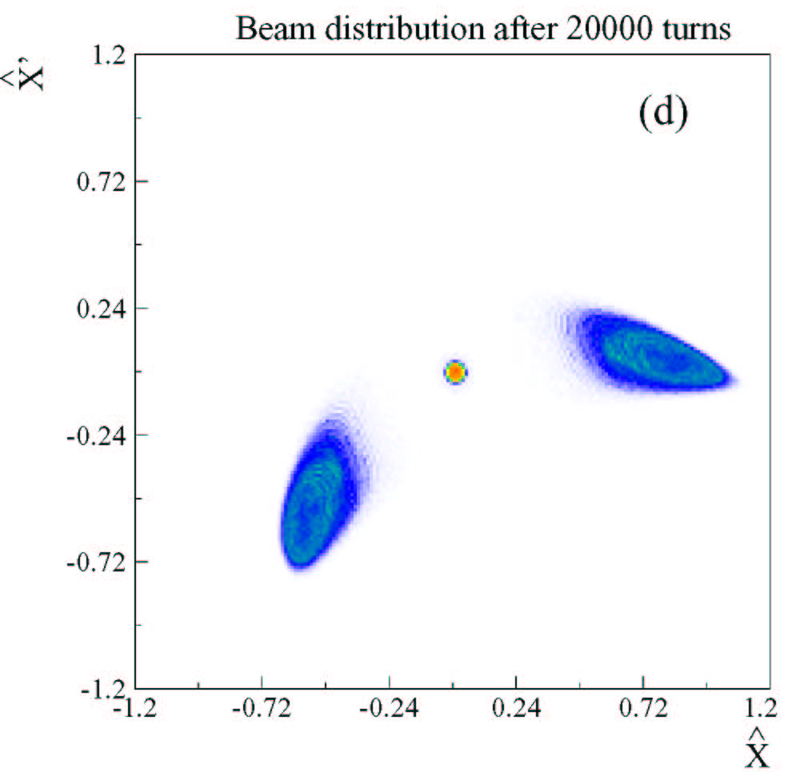
Multi-Turn Extraction with other resonances
The second-order resonance is used, thus giving a two-turn extraction
The fifth-order resonance is used, thus giving a six-turn extraction

Slide 7
Static stable islands - I
Some observations
  Two closed orbits are simultaneously available: the standard one and that related with the fixed points inside the stable islands.
  The length of the closed orbit related to the fixed points is longer than the ring circumference.
  The orbit related to the fixed points is sensitive to non-linear fields: possibility of independent control of the two closed orbits.

Slide 8
Static stable islands - II
Some observations
  The linear optics around the two closed orbits is different. This implies that, e.g., the momentum compaction is different.
  The optical parameters related to the fixed points is sensitive to non-linear fields: possibility of independent control of the two sets of optical parameters.
Implications (an example)
  Possibility to design septum-less injection/extraction.

Slide 9
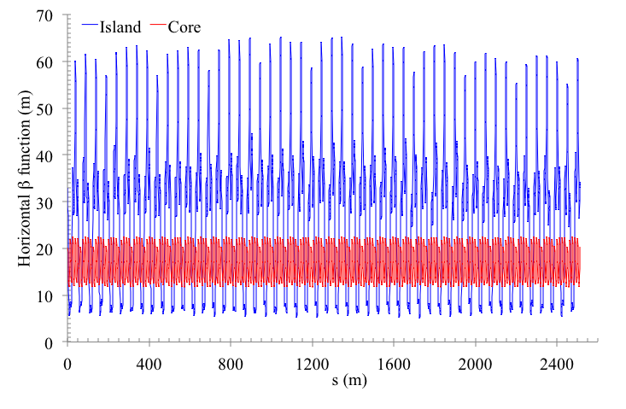
Examples based on PS ring - I
Clear difference between islands and core beta-function in H-plane: feed down from off-axis traversal of sextupoles and octupoles.

Slide 10
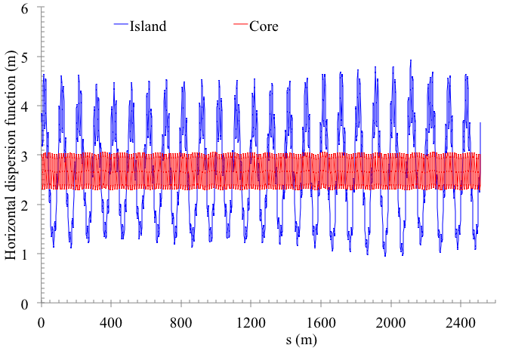
Examples based on PS ring - II
Clear difference between islands and core dispersion in H-plane: feed down from off-axis traversal of quadrupoles.

Slide 11
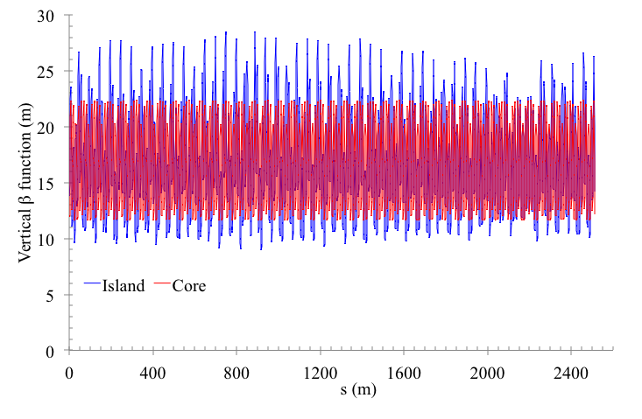
Examples based on PS ring - III
Difference between islands and core beta-function in V-plane: non-linear coupling due to sextupoles and octupoles.

Slide 12
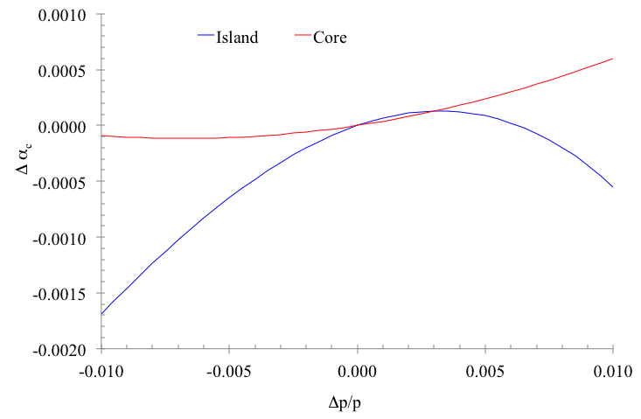
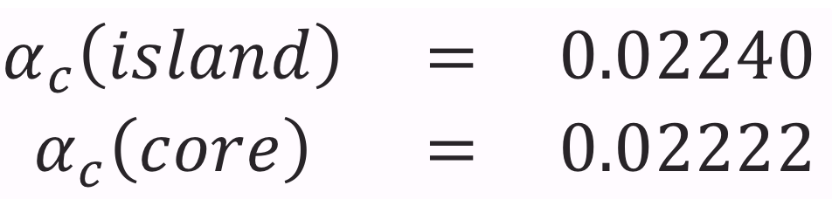
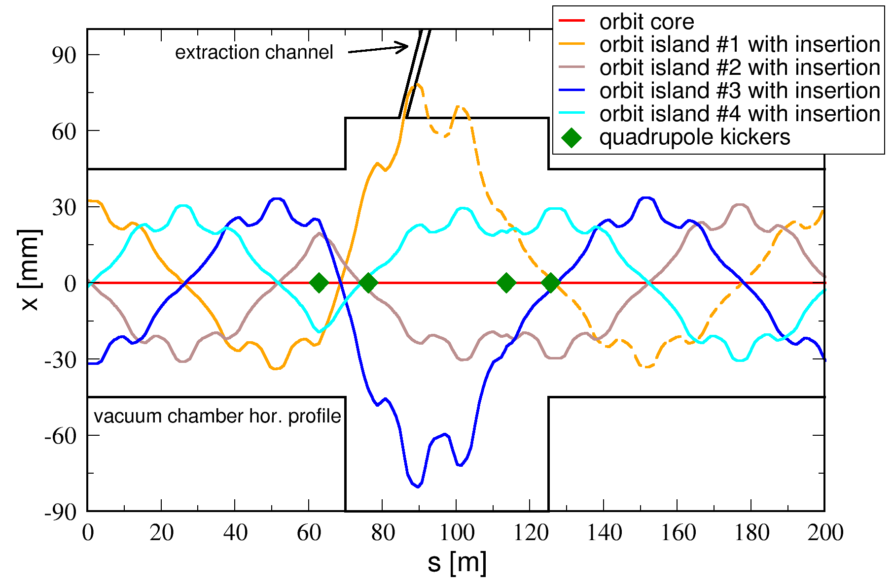
Examples based on PS ring - IV
Difference (0.8%) in α_{c} between islands and core.
Difference (factor 2) in α_{c} between islands and core.
islands: α_{c}=3.10e-2
core:
α_{c}=1.73e-2

Slide 13
Stable islands for lepton rings - I
A number of fundamental questions should be addressed first
  Are the computing codes adapted to evaluating the properties of stable islands?
  Are stable islands possible at all in presence of damping and diffusion?
All examples are based on the ESRF lattice with special settings
Computer codes (mainly) used
  Polymorphic Tracking Code (PTC)
  Accelerator Toolbox (AT)

Slide 14
Stable islands for lepton rings - II
Computation of the fixed point (closed orbit) inside the stable islands
  Need to prepare a lattice model with N times the base lattice (if N is the resonance order).
  Need to search for closed orbit far from (0, 0).
Diffusive effects
  Estimated by plain tracking
  Estimated by the computation of a diffusion matrix. This is a local approach, e.g.
    It cannot be used to simulate diffusion around the islands AND around the centre
    It is not accurate (enough) far from the fixed point due to the presence of non-linear effects
In the following, all animations are stroboscopic views (N=3).

Slide 15
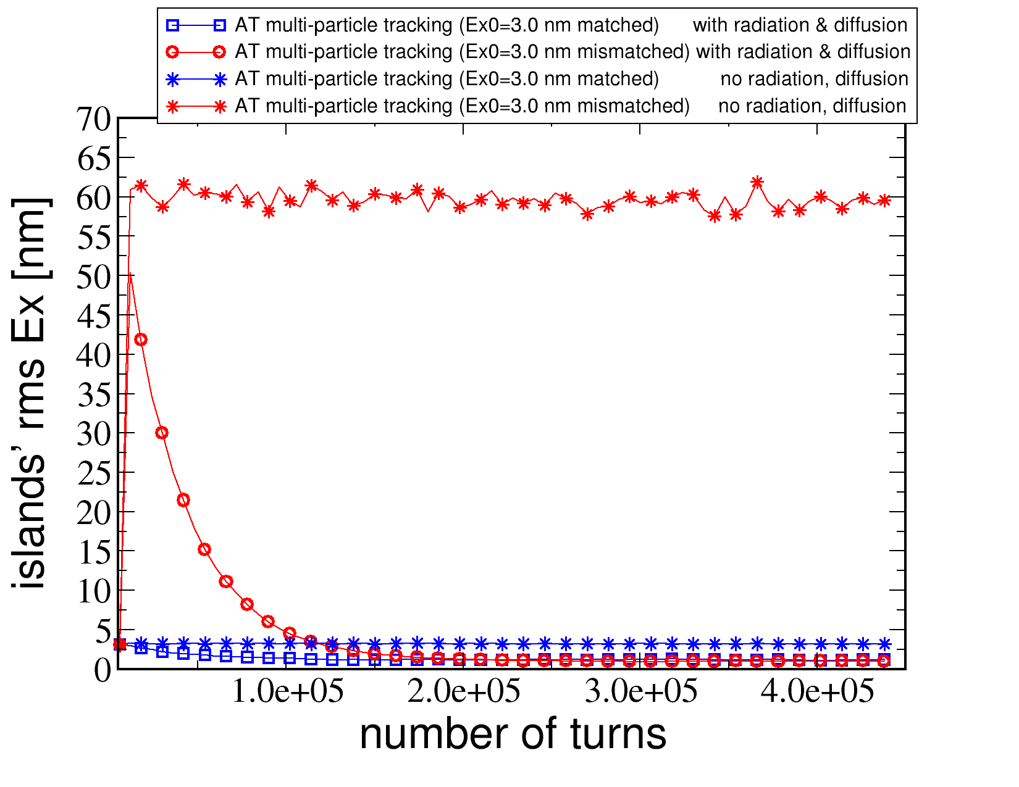
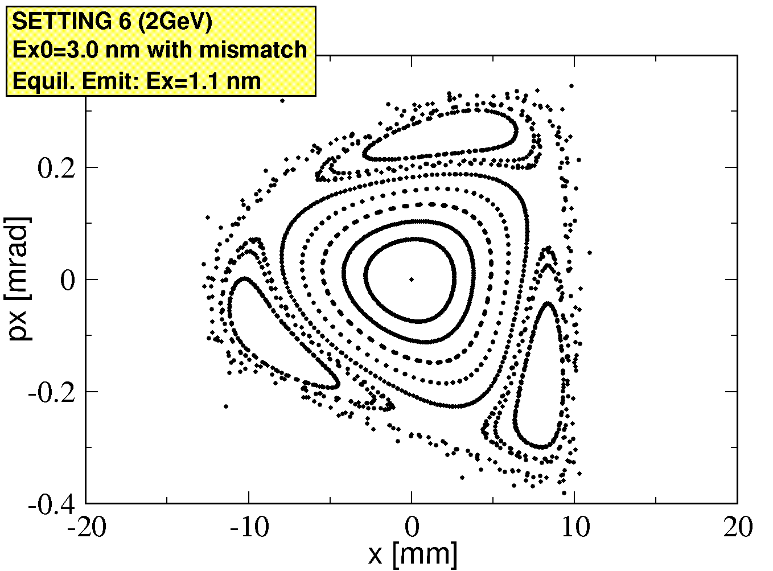
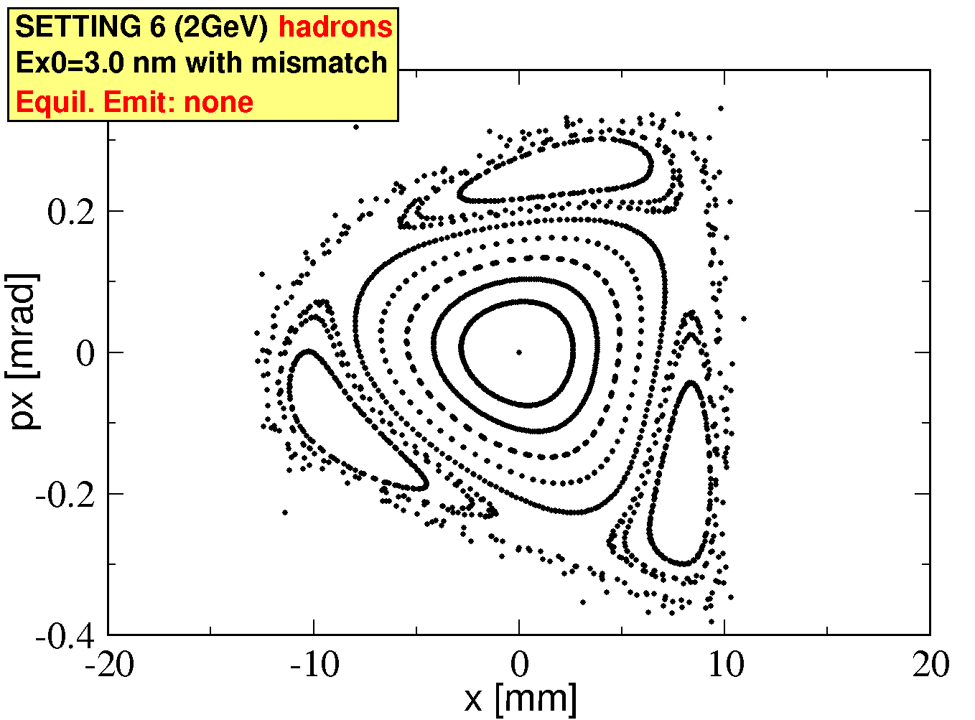
Hadrons vs Leptons
Comparing
  hadrons (Equilibrium emittance from filamentation only)
  leptons (Equilibrium emittance from radiation damping and diffusion)

Slide 16
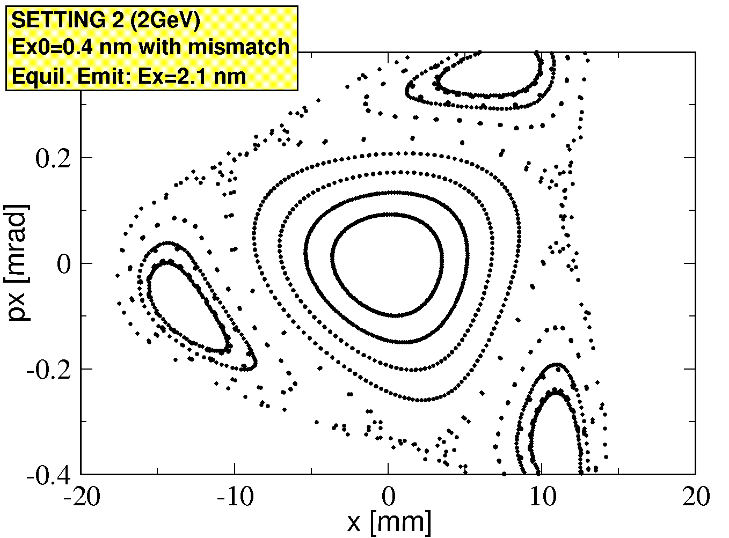
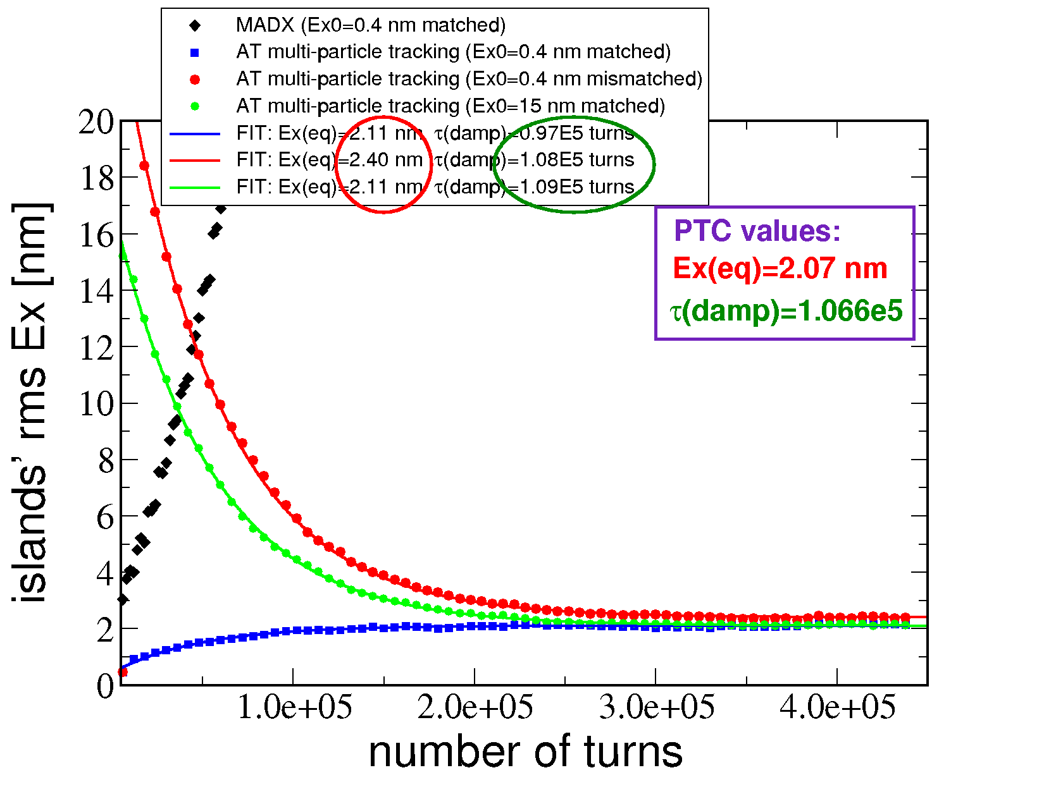
Codes comparison
 | Equil. Ex nm | τ_{damp} 10⁵ turns
PTC_{(TWISS)} | 2.07 | 1.07
AT_{(TWISS)} | 0.74 | N.A.
MADX_{(track)} | N.A. | N.A.
AT_{(track)} | 2.2±0.2 | 1.05±0.07
Summary: standard formulae adapted to take into account feed-down effects are valid for leptons in stable islands!

Slide 17
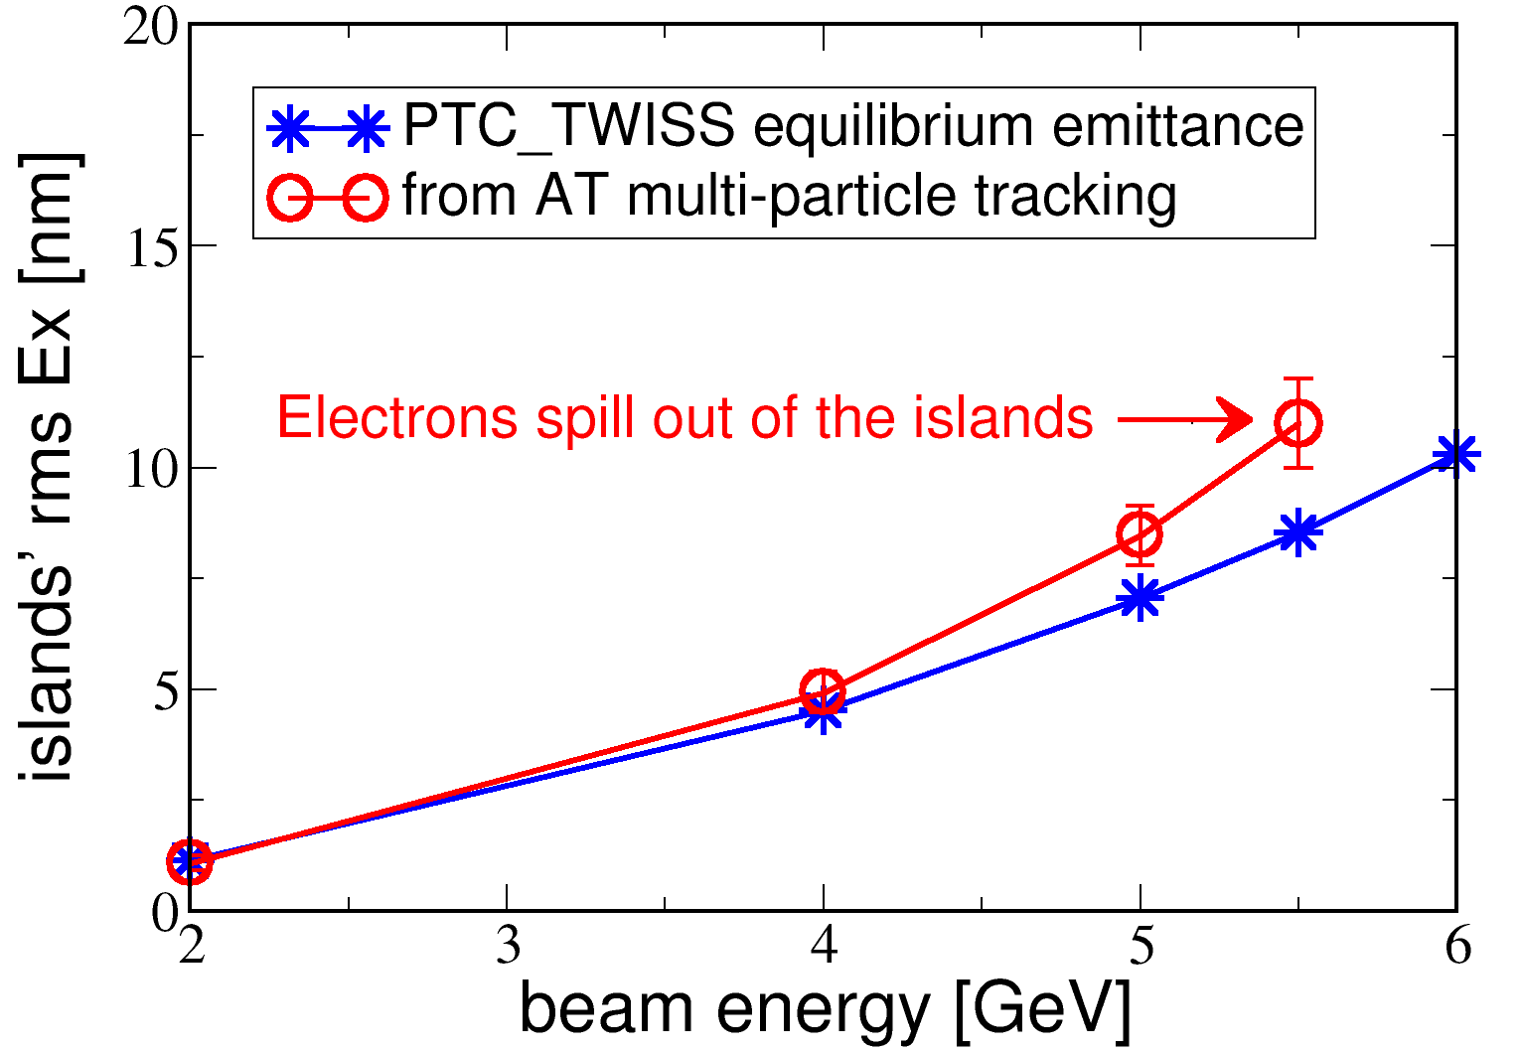
Dependence on energy
No equilibrium reached by multi-particle simulation at 6 GeV => equilibrium emittance (10.3 nm) too close to island’s stable area.
Electrons go back to the core (nominal on-axis orbit): continuous excitation is needed to keep islands populated.
A configuration with an equilibrium emittance (much) smaller than island’s stable area shall be used for operation (beam parameters from island’s linear optics, no need of continuous excitation)
When equilibrium emittance approaches island’s stable area (~10 nm) non-linear effects add to quantum diffusion: linear theory is no more valid.

Slide 18
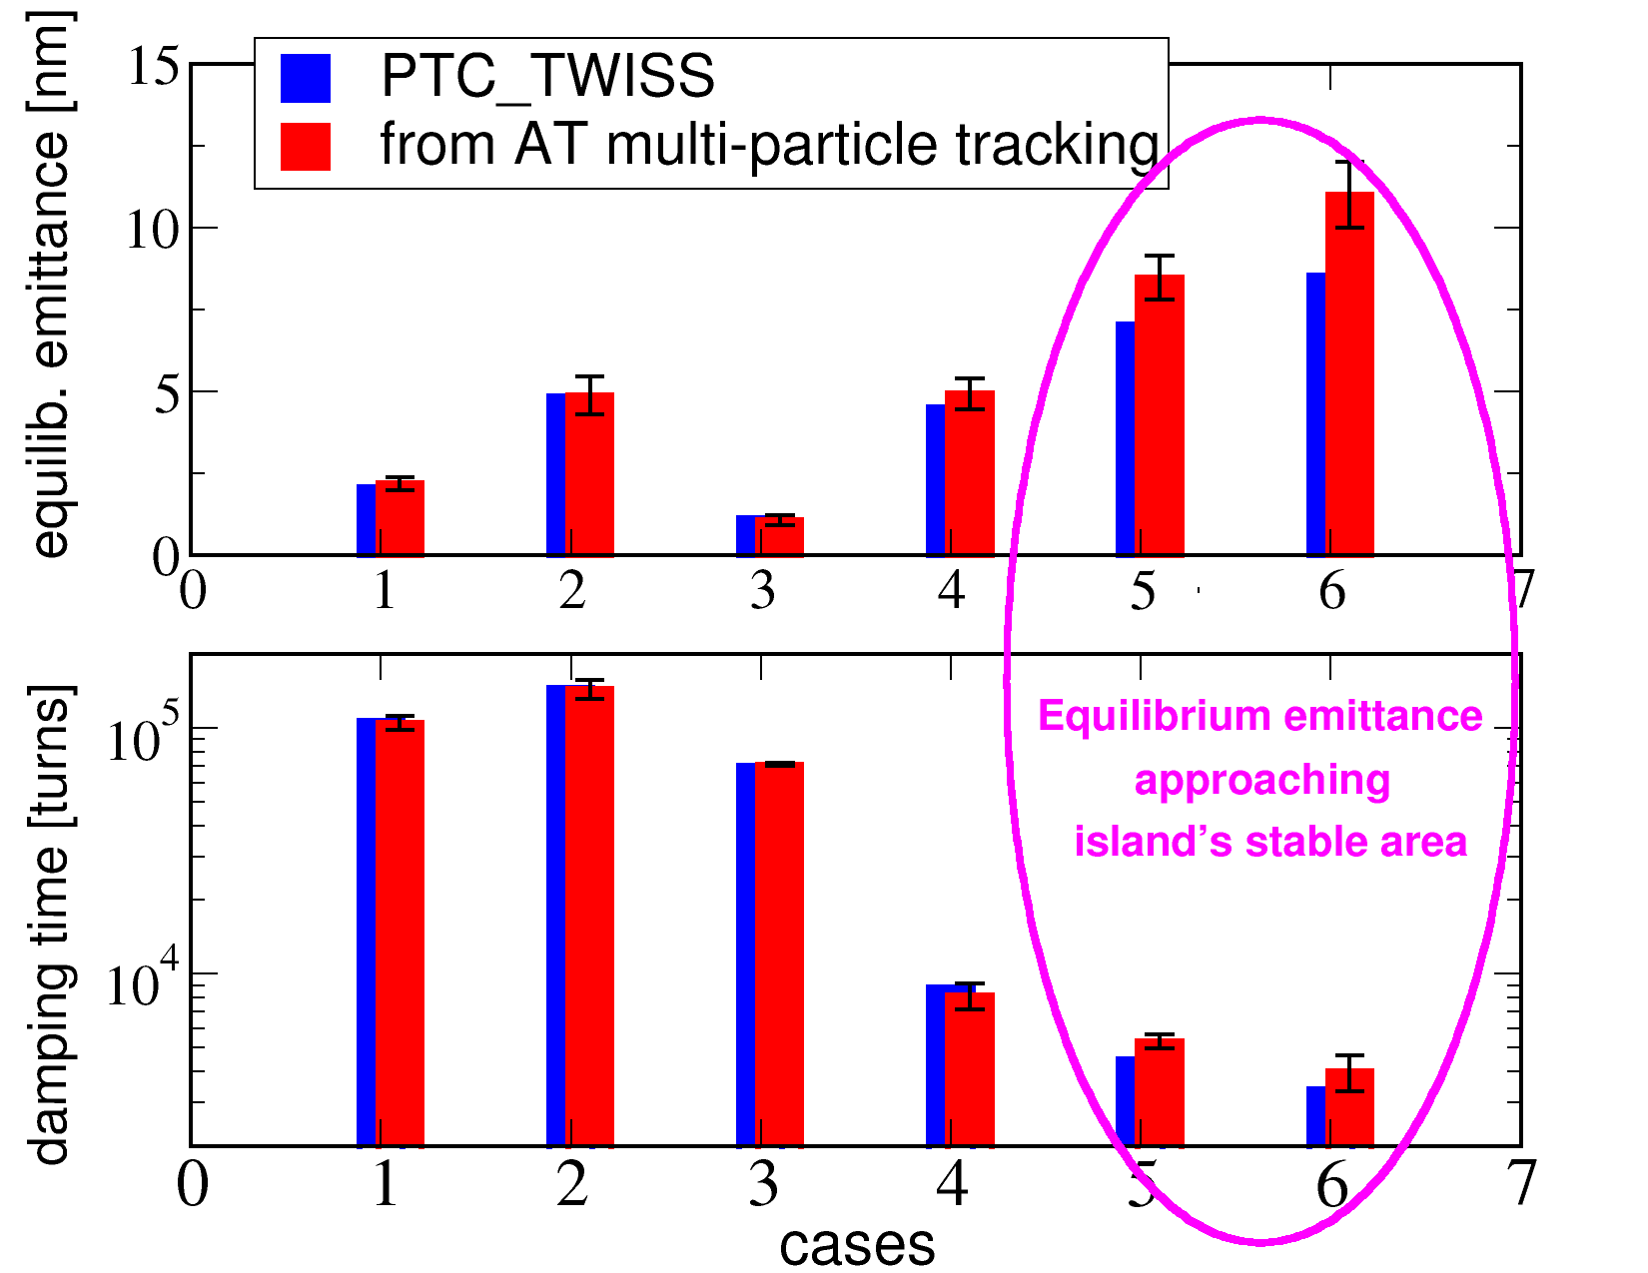
Horizontal equilibrium parameters

Slide 19
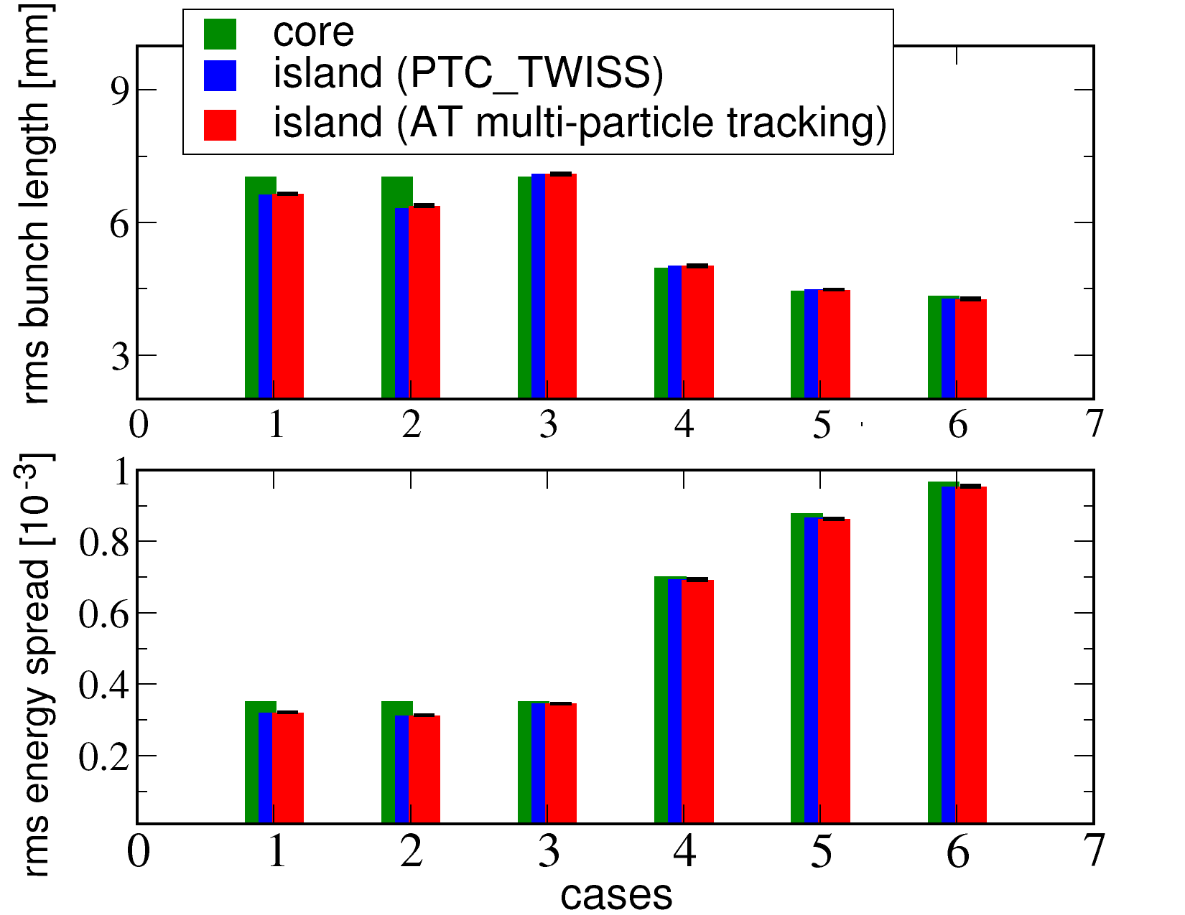
Longitudinal equilibrium parameters
Possibility to change bunch length between core and islands

Slide 20
Applications of stable islands to lepton machines - I
The case of static islands
  Design stable islands providing different equilibrium parameters with respect to core: possibility of serving simultaneously users requiring different beam characteristics. Islands can be populated by means of transverse kickers.

Slide 21
Applications of stable islands to lepton machines - II
The case of dynamic stable islands
  Use transversely split beams in conjunction with undulators to feed simultaneously several beam lines (simplifies canted beam lines). It requires beam splitting, hence dynamic use of stable islands
  Top up, by injecting into islands and then collapsing them onto the central closed orbit. It requires a dynamic use of stable islands.
Dynamic stable islands with damping and diffusion is the next step!

Slide 22
Conclusions and outlook
Several applications of stable islands to circular accelerators have been proposed.
Till now, the main domain of applicability is hadron machines.
Beam splitting has been proven in operation at CERN PS.
For the case of lepton machines
  Stable islands are possible!
  Equilibrium parameters can be estimated by generalised versions of the standard formulae.
  Non-linear dynamics comes into play and its impact might be crucial (for equilibrium parameters and transient behaviour).
  Several applications are at hand…

Slide 23
Thank you!

Slide 24
Selected references
A. Huschauer et al., Phys. Rev. Accel. Beams 20, 061001 (2017)
S. Abernethy at al., Phys Rev. Accel. Beams 20, 014001 (2017)
J. Borburgh et al., EPL 113 34001 (2016)
A. Franchi, M. Giovannozzi, Phys. Rev. ST Accel. Beams 18, 074001 (2015)
A. Bazzani et al., Phys. Rev. E 89, 042915 (2014)
S. Gilardoni, M. Giovannozzi, C. Hernalsteens, Phys. Rev. ST Accel. Beams 16 051001 (2013)
M. Giovannozzi, D. Quatraro, G. Turchetti, Phys. Rev. ST Accel. Beams 12 024003 (2009)
A. Franchi, S. Gilardoni, M. Giovannozzi, Phys. Rev. ST Accel. Beams 12 014001 (2009)
M. Giovannozzi and J. Morel, Phys. Rev. ST Accel. Beams 10 034001 (2007)
S. Gilardoni at al., Phys. Rev. ST Accel. Beams 9 104001 (2006)
R. Cappi, M. Giovannozzi, Phys. Rev. ST Accel. Beams 7 024001 (2003)
R. Cappi, M. Giovannozzi, Phys. Rev. Lett. 88 104801 (2002)

Slide 25
Reserve slides

Slide 26
Introduction - I
Application of stable islands in CERN machines started with PS, aiming at replacing the Continuous Transfer (CT) from PS to SPS
PS
PS
C_{SPS} = 11 C_{PS}
SPS circumference
First PS batch
Second PS batch
Gap for kicker
X’
2
E_{field}≠0
Slicing is performed during extraction
3
5
1
X
4
Electrostatic septum wires
E_{field}=0

Slide 27
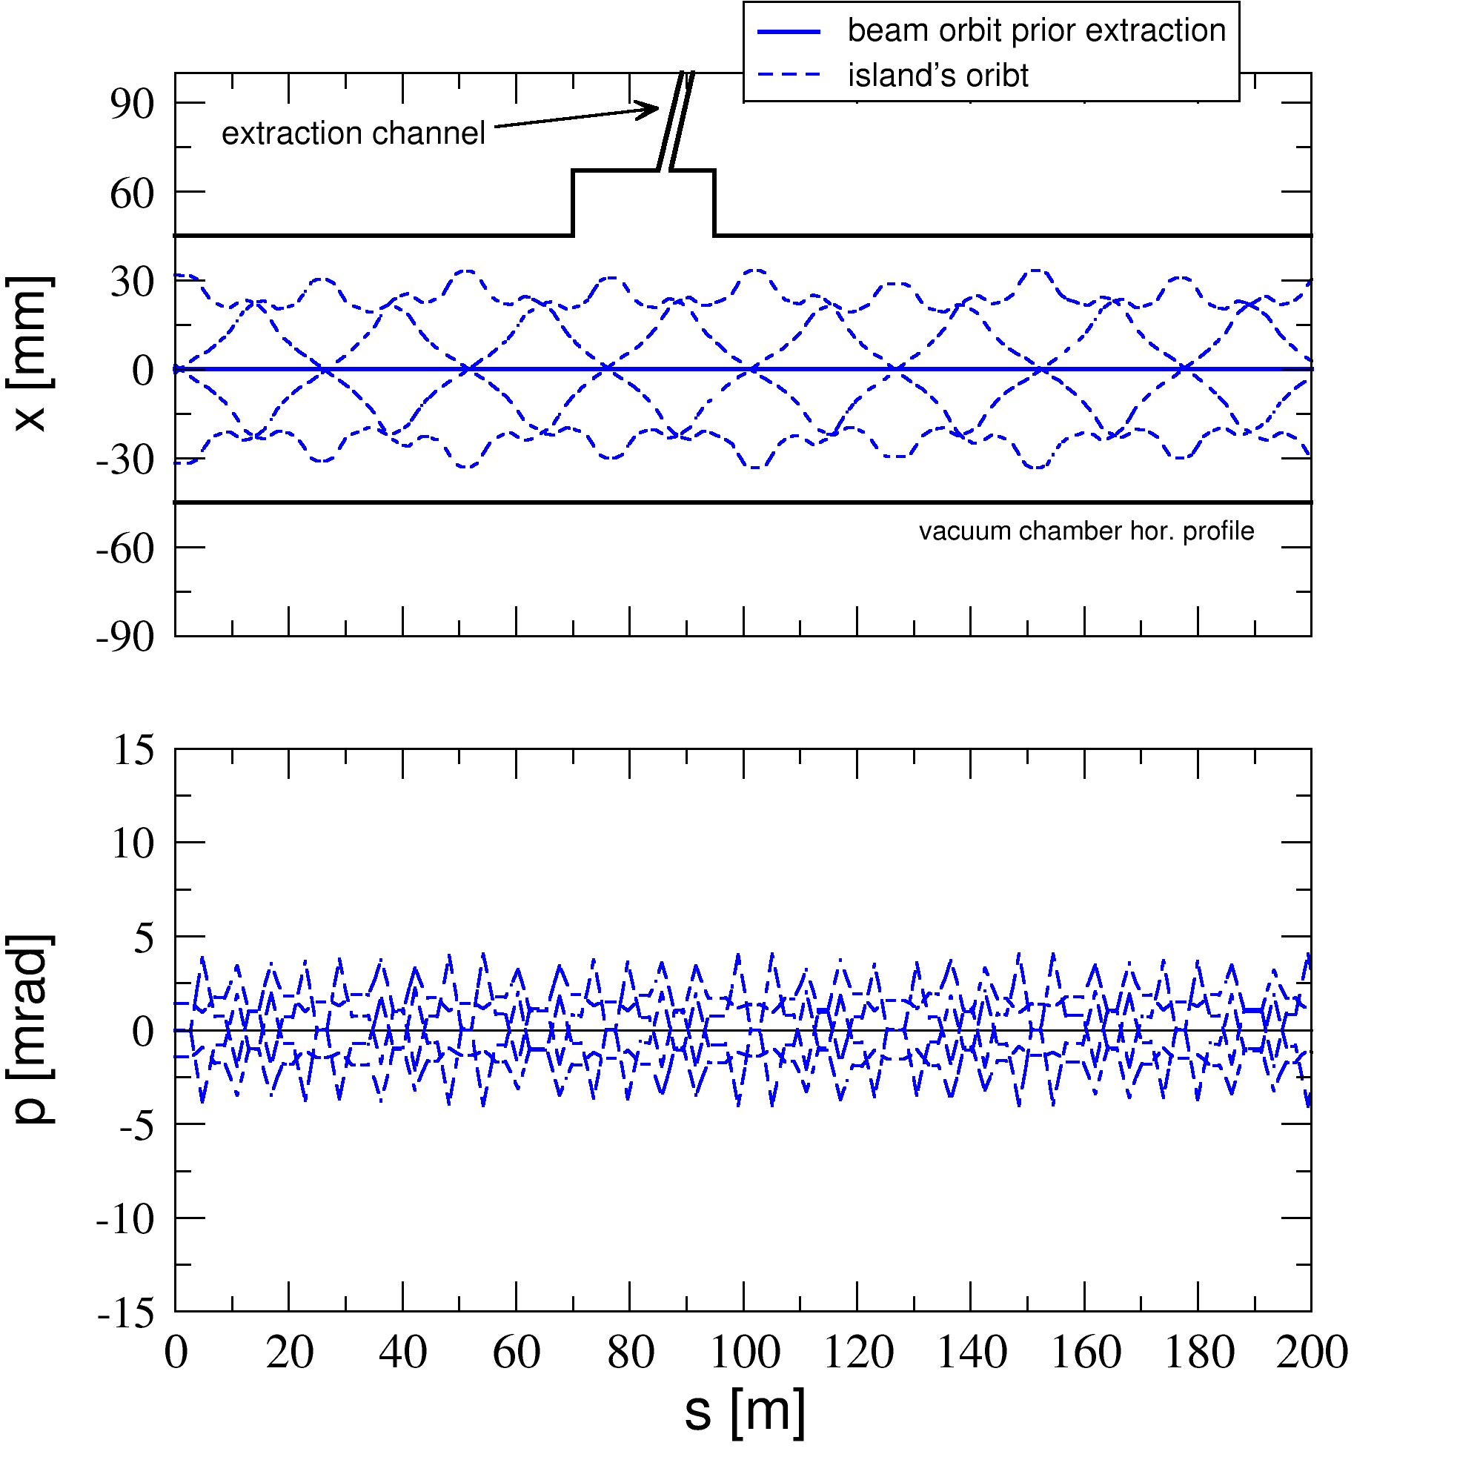
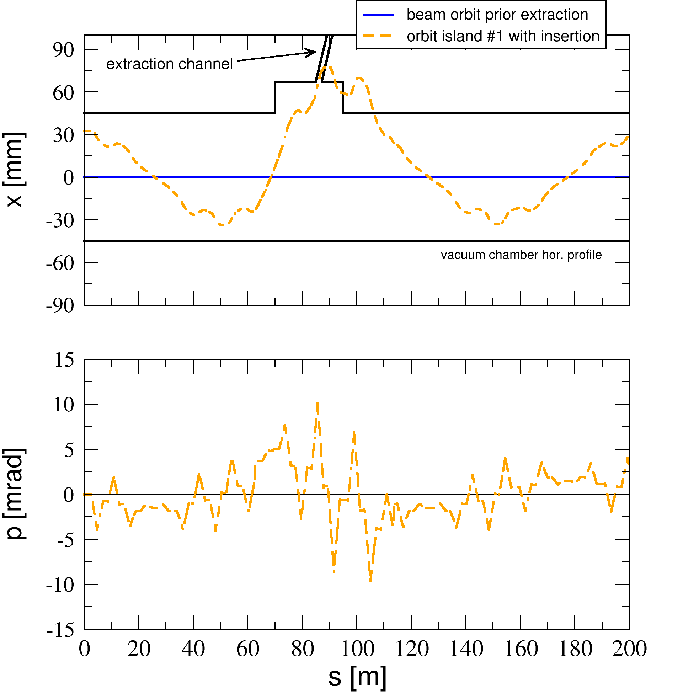
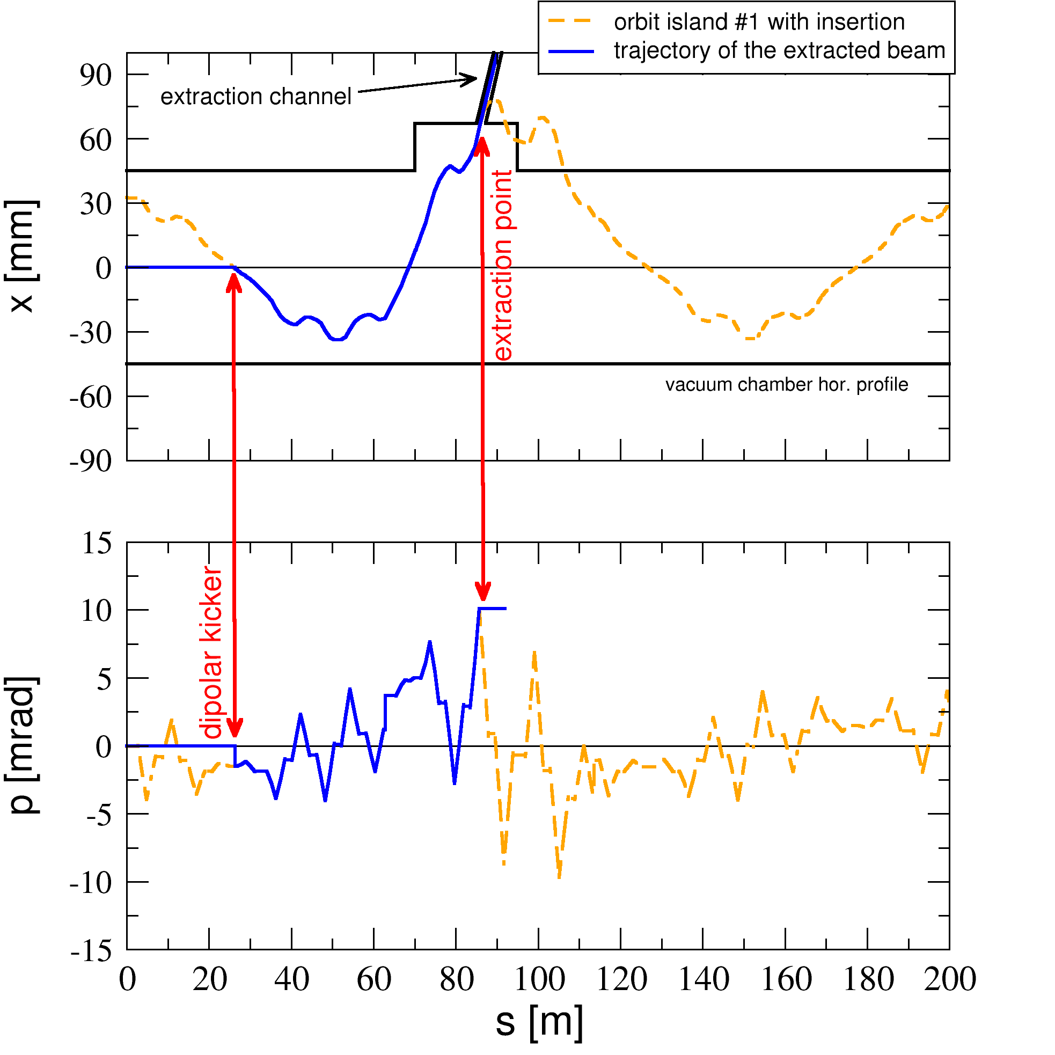
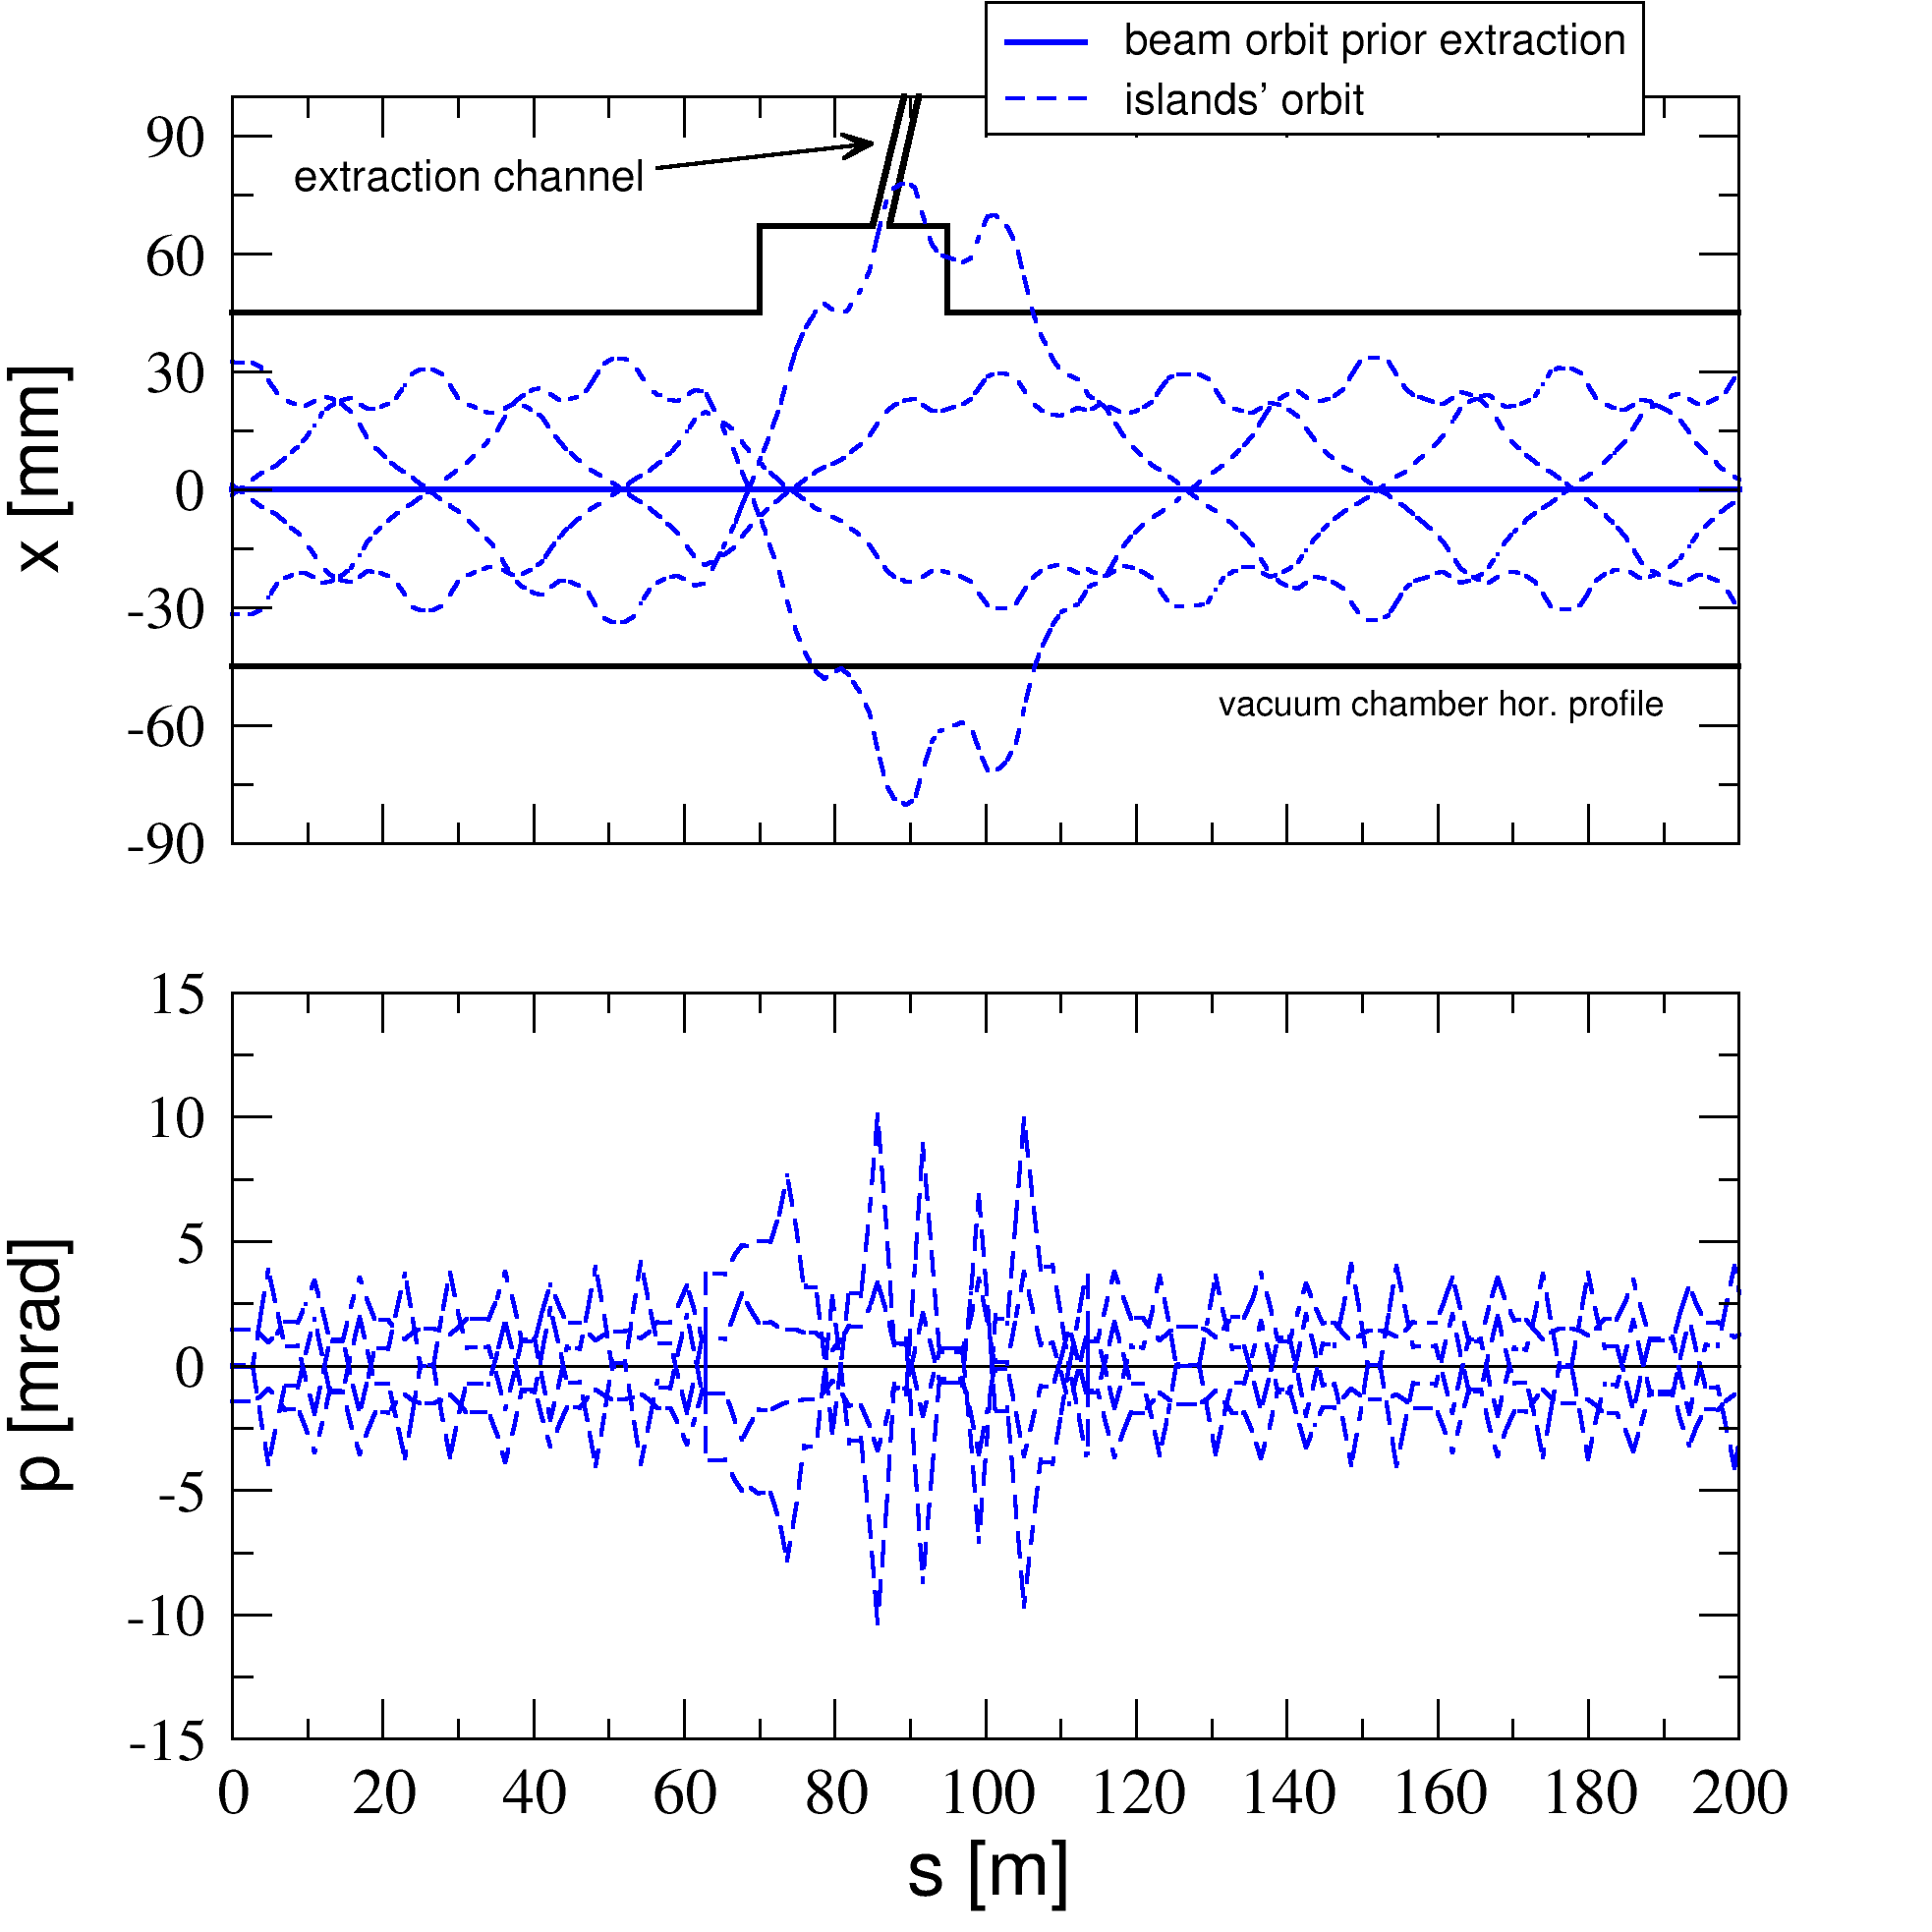
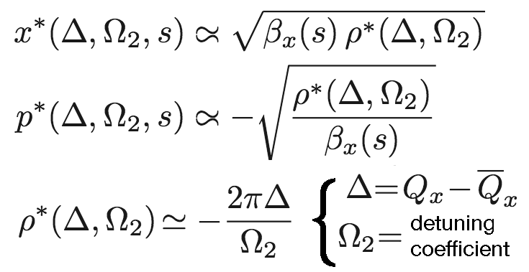
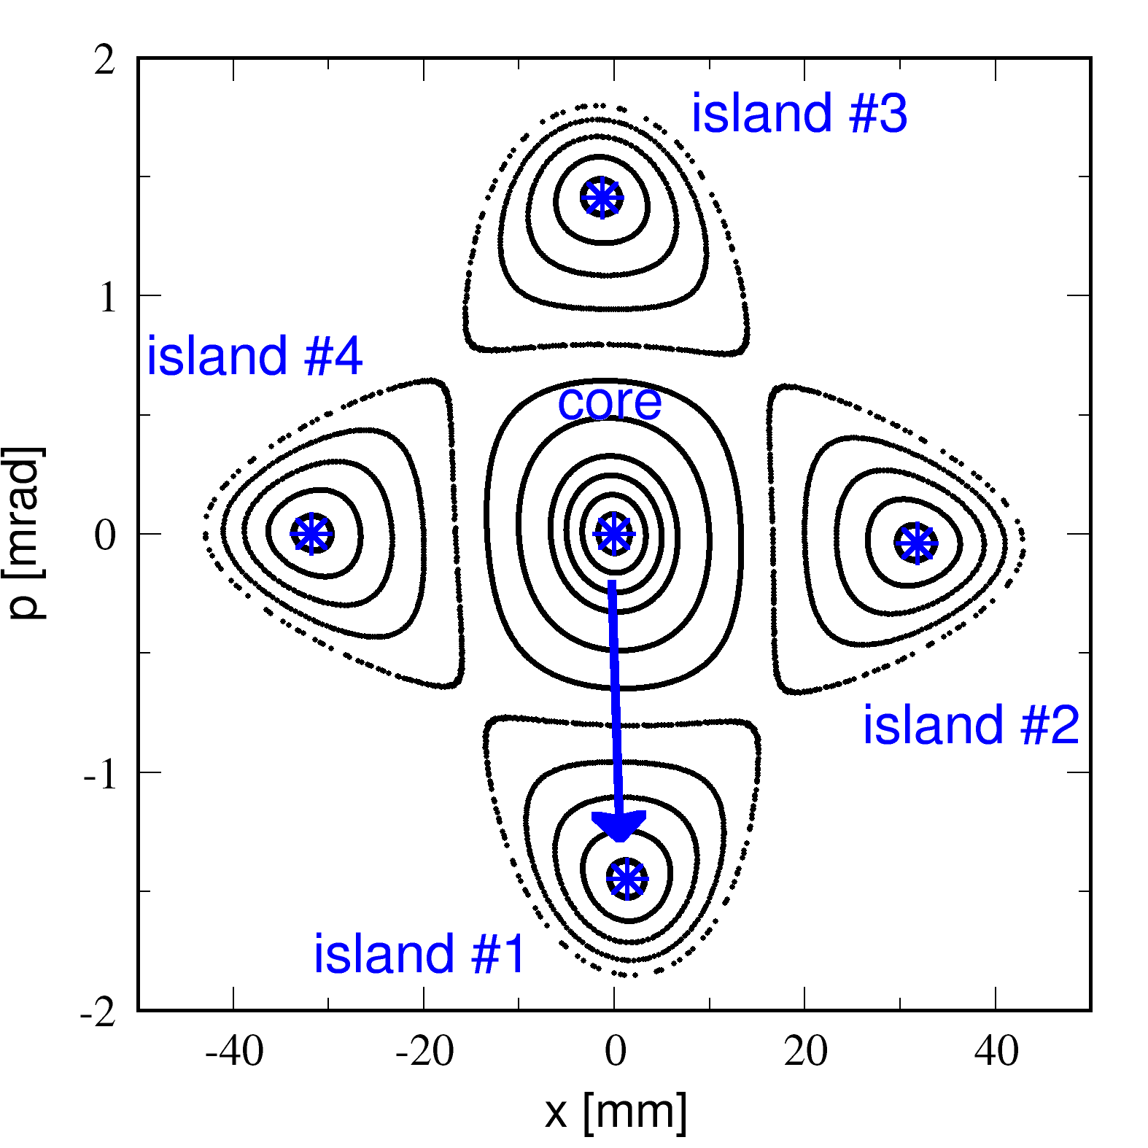
Septum-less extraction or injection
to avoid insertion optics (unpopulated) islands may be displaced by moving Q_{x} only
step 1: generate (though do not populate) four islands. the beam remain on axis
step 2: introduce the insertion optics via quadrupole bumpers, not kickers (actually not needed)
step 3: install and pulse a dipole kicker at a waist to move the beam from the axis to the island

Slide 28
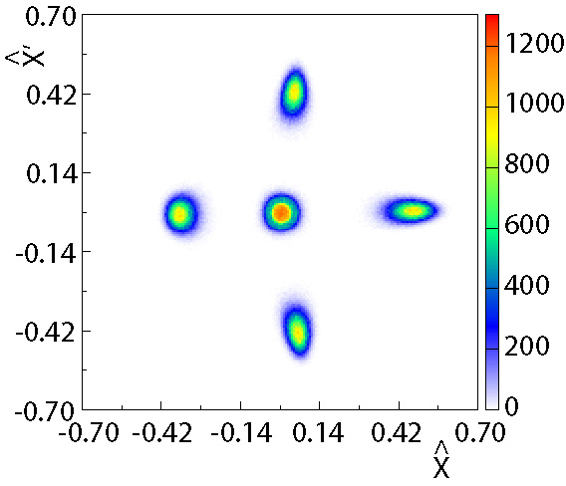
MTE: extraction process
Final stage after 20000 turns (about 42 ms for CERN PS)
At the septum location
B_{field} = 0
B_{field} ≠ 0
Slow (few thousand turns) bump first (closed distortion of the periodic orbit)
Fast (less than one turn) bump afterwards (closed distortion of periodic orbit)
About 6 cm in physical space

Slide 29
A brief history of MTE
2008-9: Initial beam commissioning. Bunched beams used and occasionally sent to SPS.
2010: Short operational period. Observed:
  Increase of irradiation of the extraction region. This is due to the longitudinal beam structure (continuous).
  Poor reproducibility of the trapping efficiency
  Poor reproducibility of extraction trajectories
2010-12: Reproducibility studies. Looking for physical observable(s) correlated with the trapping.
2013-14: Installation of dummy septum and beam commissioning. This is the solution to the increased irradiation in the extraction region.
2015: Successful beam commissioning and operation.

Slide 30
2015 beam commissioning and operation
History of the 2015 MTE run
CT
Courtesy C. Hernalsteens

Slide 31
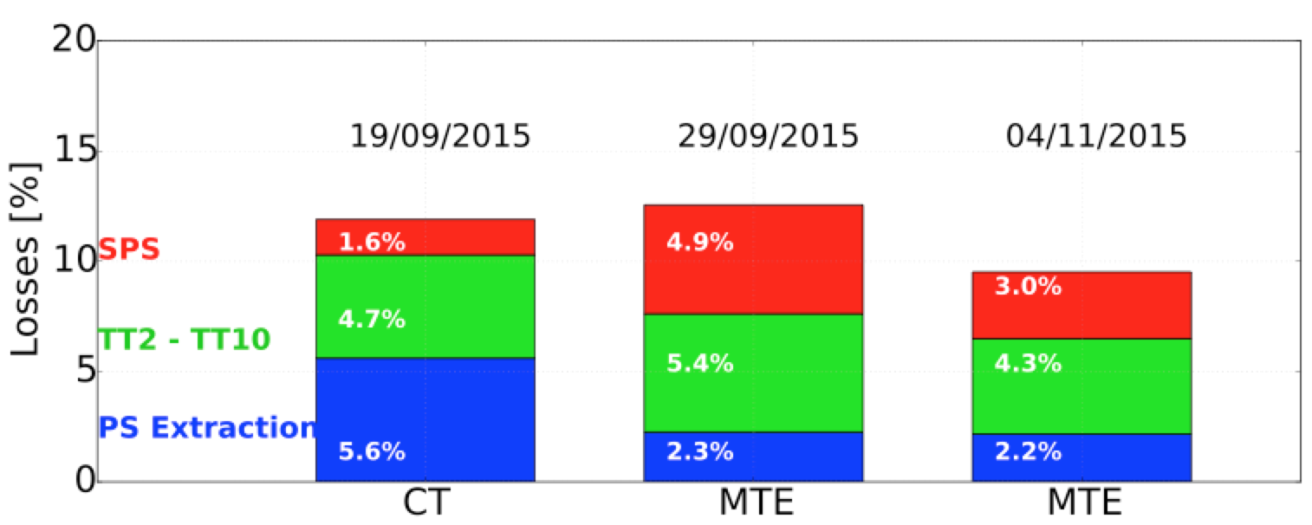
2015 beam commissioning and operation
History of the 2015 MTE run
Losses from PS flattop to SPS flattop. Three configurations are shown: CT operation early 2015 (left), initial MTE operation (centre) and improved MTE operation (right).
Courtesy C. Hernalsteens

